Slide 1

EPS ADDITIVES –
An Overview to Wuxi XingDa, Wuxi, China

Slide 2
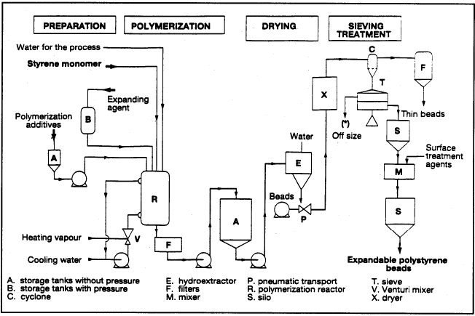

Slide 3

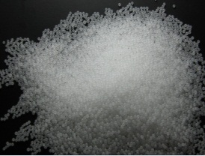
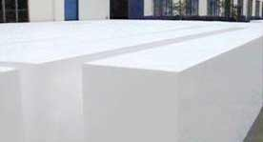
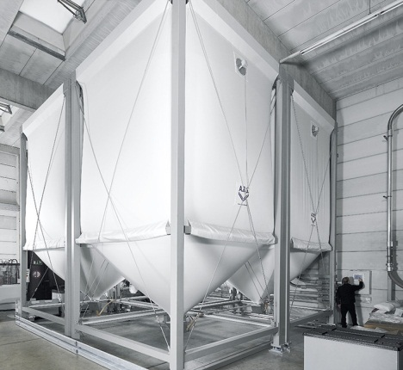
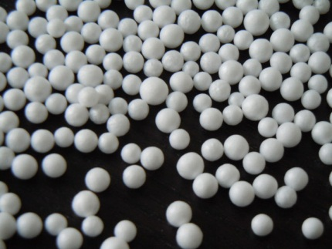
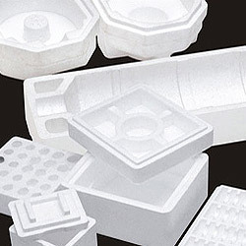
ADDITVE BLEND
Styrene/Water
Blowing Agent
Polymerisation
DRYING + SIEVING
COATING

Slide 4
The Role of the Coating
Uncoated EPS beads provide only poor processing characteristics
Polystyrene beads and pre-foams acquire various quantities of static charge
During pre-foaming the particles tend to fuse together at processing temperature
Performance at final molding step far from optimum
Processing time is too long
Final product quality is bad
An optimised coating reduces production costs and improves final product quality

Slide 5
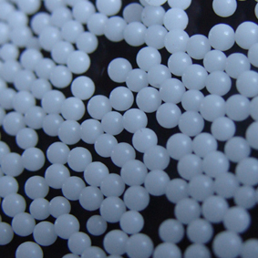
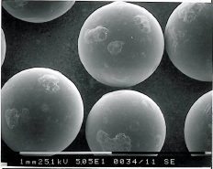
The Coating Result

Slide 6
Influencing the Coating Result
The Additive composition
Additive chemistry
Powder properties
2. Blending equipment

Slide 7
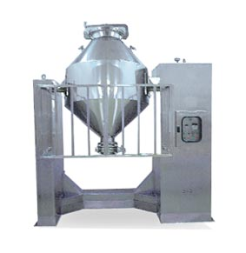
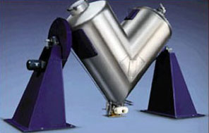
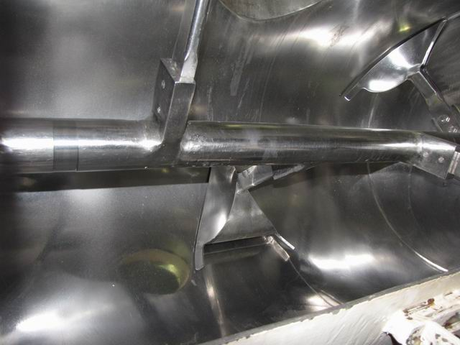
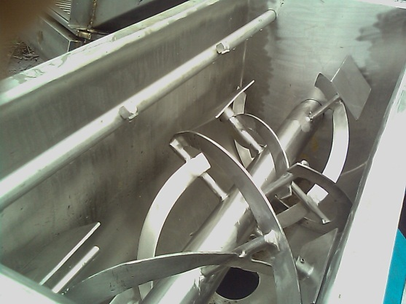
Solid – Solid Blenders
Twin-Shell Blender
Double-Cone Blender
Plough shear Blender
Ribbon Blender

Slide 8
Product Range of Additives
IOI OLEO GmbH is a leading supplier of processing agents to the EPS Industry
We can offer coating additives like:
Different types of Glycerol mono stearates
Different types of Glycerol tri stearates
Customer specific Blends
In Addition
Antifoam agents (WITAFROL)
Antistatic agent during sieving (SOFTENOL 3767)

Slide 9
SOFTENOL coating additives
SOFTENOL has a decisive effect on each stage of EPS processing
Taking the processing procedure for EPS as a whole, an
optimum effect can be achieved by blending different types
of additives.
Cremer Oleo offers those mixtures also under the tradename SOFTENOL
The pre-expansion step is mainly influenced by more polar substances like
SOFTENOL 3995 or SOFTENOL 3945
The fusion stage needs more unpolar grades like
SOFTENOL 3118, 3169 or 3168

Slide 10
Additives/Blends with special properties
We can also offer additives/blends with special properties.
For example:
Coating for low pentane grades
Coating in order to reduce the water absorption

Slide 11
Ready to Use Mixtures
IOI Oleo GmbH offers Ready to Use Mixtures
our tailor made solutions to optimize the efficiency of the customers
EPS processing line

Slide 12
Every effective coating is a blend of several substances. Each component
has, as said, a decisive effect on a defined stage of processing.
The coating composition has to be balanced carefully, because the different components show desirable results at one stage of processing and may have adverse effects at the next.

Slide 13
EPS coated with Blend A - resulting pre-foam

Slide 14
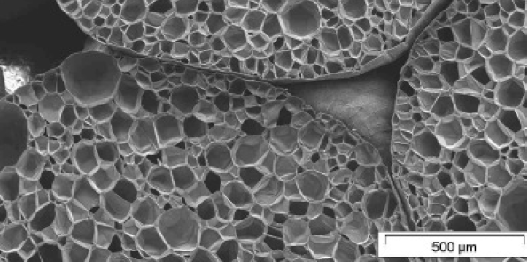
EPS coated with Blend A - resulting mold
Binding strength 17 N

Slide 15
EPS coated with Blend B - resulting pre-foam

Slide 16
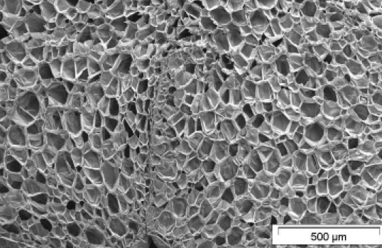
EPS coated with Blend B - resulting mold
Binding strength 63 N

Slide 17
Fusion step - Cycle time reduction versus additive composition and concentration

Slide 18
Recommendation on additive concentration
Bead size [mm] | 0.4-0.6 | 0.6-1 | 1-1.3 | 1.3-2
Additive [% b.w.] | 0.5 | 0.3 | 0.2 | 0.1

Slide 19
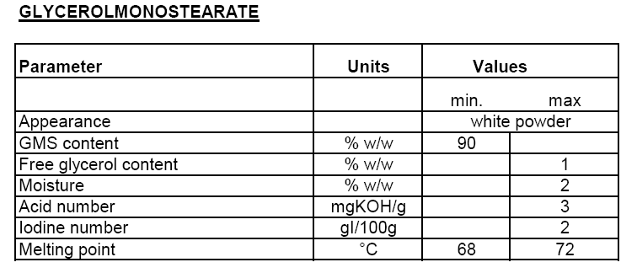
Glycerol Mono Stearates –

Slide 21
Glycerol Tri Stearates –

Slide 22
Glycerol Tri Stearates

Slide 23
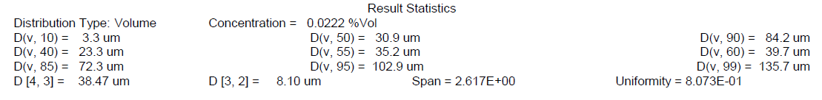
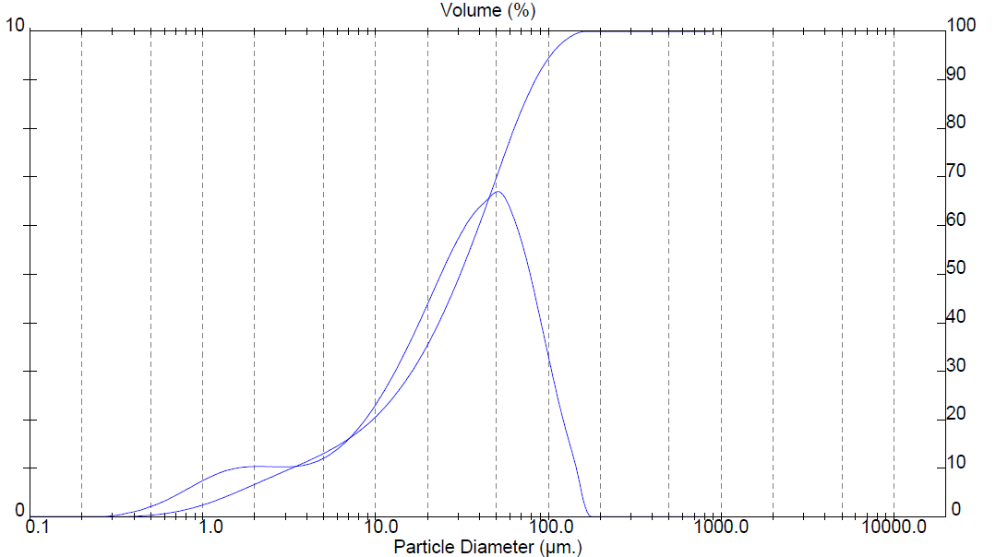

Slide 24
Citric acid ester of long chain fatty alcohols
4. SOFTENOL 3352
Parameter | Units | Values
 |  | min. | max
Appearance |  | white powder
Saponification number | mgKOH/g | 147 | 158
Hydroxyl number | mgKOH/g | 9 | 20
Acid number | mgKOH/g |  | 5
Melting point | °C | 65 | 72

Slide 25
Development of Blends
Our preferred way to cooperate with you is:
1) you send us samples of coated and uncoated fresh EPS
2) we coat the uncoated EPS and do tests in our application lab
3) you will do an industrial test with our recommended blend(s)

Slide 26
Components versus Blends – A comparison of handling costs
Storage for components; e.g. GMS, GTS, Metalsoaps
Quality control prior use
Quality control on delivery
Blending basic components
Storage of „Ready-to-use“ Blend
Quality control prior use
Storage of additive blend
Coating of EPS beads
Coating of EPS beads

Slide 27
Cultivating Partnership, Enhancing Value

Slide 28






